Slide 1
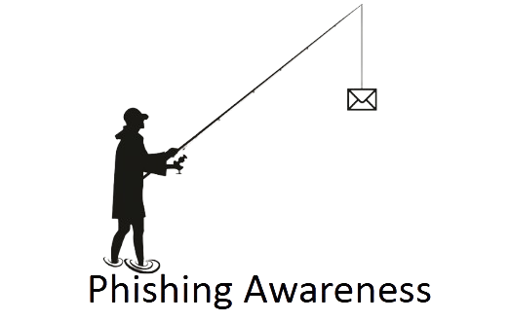
Phishing Awareness Training
Learn how to identify and avoid phishing attacks.
Created by: Kabir Rathod Code Alpha Internship -Task 2

Slide 2
What is Phishing?
Definition:
Phishing is a cyber attack technique where attackers trick users into revealing sensitive information like passwords, credit card numbers, or OTPs.
Goal:
Gain access to personal or company accounts by pretending to be a trusted source.
Example: You receive an email claiming to be from your bank asking to “verify your account.”

Slide 3
Common Types of Phishing
Email Phishing - Fake emails pretending to be from trusted
organizations.
Spear Phishing - Targeted emails toward specific individuals.
Smishing - Phishing through SMS messages.
Vishing - Voice phishing via phone calls.
Clone Phishing - Duplicate of a real email with malicious links.

Slide 4

How to Recognize Phishing Emails
⚠️ Red Flags to Look For:
Suspicious or misspelled sender address
Poor spelling/grammar
Urgent tone (“Your account will be locked!”)
Links that look slightly different (paypa1.com instead of paypal.com)
Unexpected attachments

Slide 5
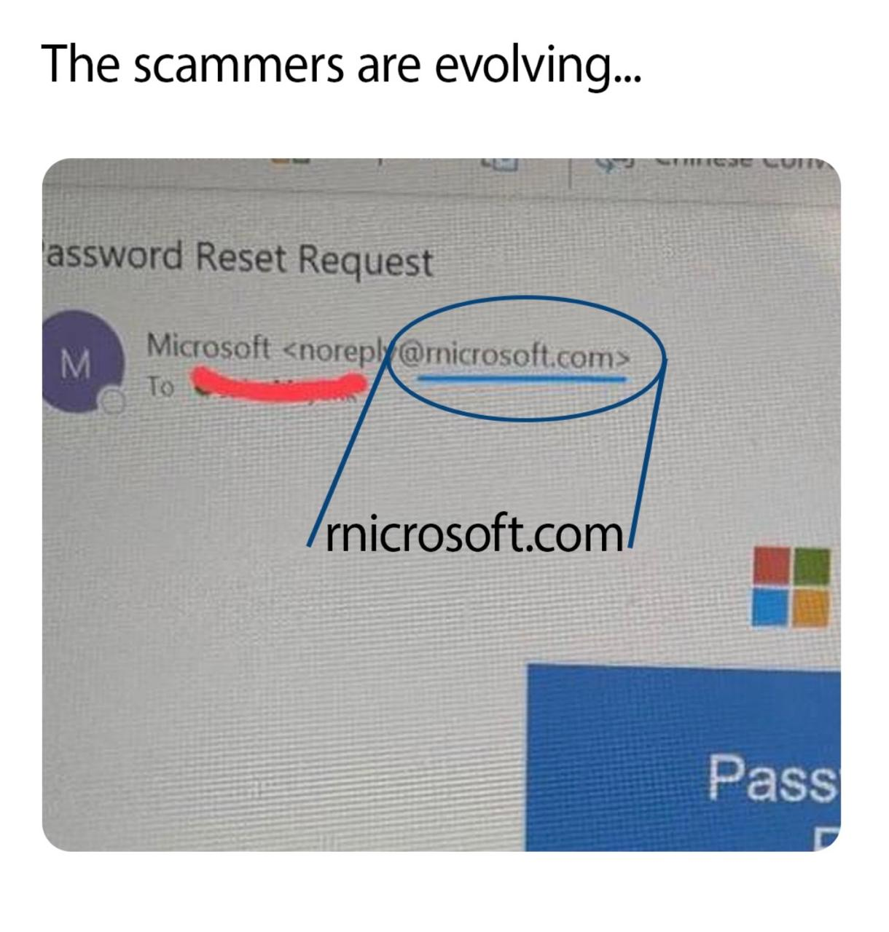
Phishing Example
Fake Website Example:
Real: https://www.google.com
Fake: https://www.go0gle.com
Always check:
The domain name (not just the logo!)
HTTPS lock icon
URL spelling

Slide 6
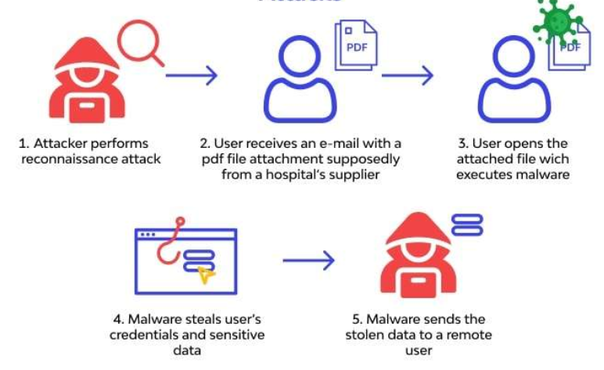
Social Engineering Tactics
Phishing relies on manipulating human behavior.
Common tactics:
Pretexting: Fabricating a believable story (ex. fake HR message)
Baiting: Offering something free to lure victims
Impersonation: Pretending to be a trusted person
Fear or urgency: “Immediate action required!”

Slide 7
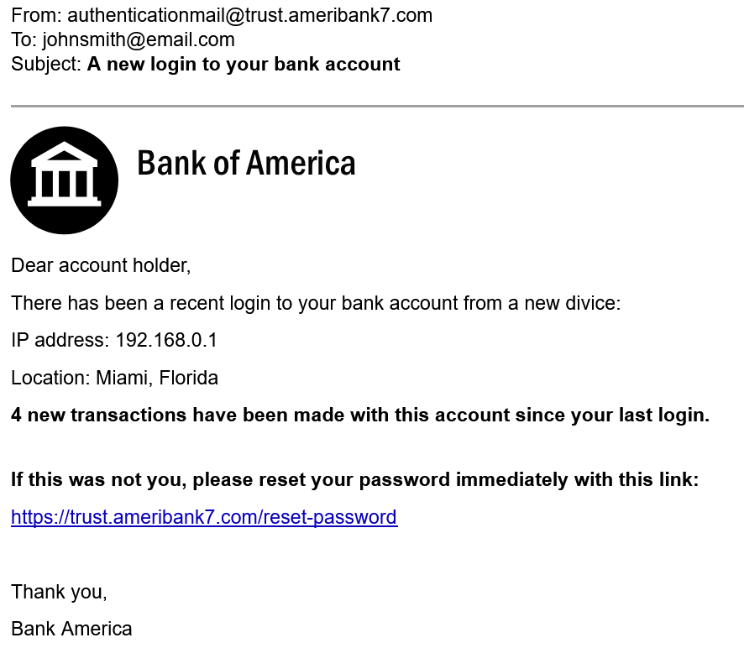
Real-World Examples
Fake Bank Alerts — Your account is blocked. Click here to verify.
Job Offer Scams — Fake recruiters requesting personal details.
Delivery Notifications — Your parcel is held. Pay ₹50 to release.
Password Reset Emails — Sent from lookalike domains.

Slide 8

How to Protect Yourself
Best Practices:
Verify the sender before responding.
Do not share OTPs or passwords.
Use multi-factor authentication (MFA).
Keep your system and antivirus updated.
Report suspicious emails to IT/security teams.

Slide 9
Do’s and Don’ts
Do’s
Check URLs carefully
Report suspicious messages
Keep your browser and software updated
Use strong, unique passwords
Don’ts
Don’t click unknown links
Don’t download random attachments
Don’t enter credentials on unknown sites
Don’t trust urgent scare tactics

Slide 10


Quiz Time
Quiz Link : https://forms.gle/5j8rPtAde9V3rde19
No login required — responses are anonymous.

Slide 11
Conclusion
🎯 Key Takeaways:
Think before you click.
Always verify the source.
Awareness is your best defense.
🔐 Stay smart. Stay safe.

